Slide 1
Data Mining: Concepts and Techniques — Chapter 2 —
Jiawei Han, Micheline Kamber, and Jian Pei
University of Illinois at Urbana-Champaign
Simon Fraser University
©2011 Han, Kamber, and Pei. All rights reserved.

Slide 2
Chapter 2: Getting to Know Your Data
Data Objects and Attribute Types
Basic Statistical Descriptions of Data
Data Visualization
Measuring Data Similarity and Dissimilarity
Summary

Slide 3
Types of Data Sets
Record
Relational records
Data matrix, e.g., numerical matrix, crosstabs
Document data: text documents: term-frequency vector
Transaction data
Graph and network
World Wide Web
Social or information networks
Molecular Structures
Ordered
Video data: sequence of images
Temporal data: time-series
Sequential Data: transaction sequences
Genetic sequence data
Spatial, image and multimedia:
Spatial data: maps
Image data:
Video data:

Slide 4
Important Characteristics of Structured Data
Dimensionality
Curse of dimensionality
Sparsity
Only presence counts
Resolution
Patterns depend on the scale
Distribution
Centrality and dispersion

Slide 5
Data Objects
Data sets are made up of data objects.
A data object represents an entity.
Examples:
sales database: customers, store items, sales
medical database: patients, treatments
university database: students, professors, courses
Also called samples , examples, instances, data points, objects, tuples.
Data objects are described by attributes.
Database rows -> data objects; columns ->attributes.

Slide 6
Attributes
Attribute (or dimensions, features, variables): a data field, representing a characteristic or feature of a data object.
E.g., customer _ID, name, address
Types:
Nominal
Binary
Numeric: quantitative
Interval-scaled
Ratio-scaled

Slide 7
Attribute Types
Nominal: categories, states, or “names of things”
Hair_color = {auburn, black, blond, brown, grey, red, white}
marital status, occupation, ID numbers, zip codes
Binary
Nominal attribute with only 2 states (0 and 1)
Symmetric binary: both outcomes equally important
e.g., gender
Asymmetric binary: outcomes not equally important.
e.g., medical test (positive vs. negative)
Convention: assign 1 to most important outcome (e.g., HIV positive)
Ordinal
Values have a meaningful order (ranking) but magnitude between successive values is not known.
Size = {small, medium, large}, grades, army rankings

Slide 8
Numeric Attribute Types
Quantity (integer or real-valued)
Interval
Measured on a scale of equal-sized units
Values have order
E.g., temperature in C˚or F˚, calendar dates
No true zero-point
Ratio
Inherent zero-point
We can speak of values as being an order of magnitude larger than the unit of measurement (10 K˚ is twice as high as 5 K˚).
e.g., temperature in Kelvin, length, counts, monetary quantities

Slide 9
Discrete vs. Continuous Attributes
Discrete Attribute
Has only a finite or countably infinite set of values
E.g., zip codes, profession, or the set of words in a collection of documents
Sometimes, represented as integer variables
Note: Binary attributes are a special case of discrete attributes
Continuous Attribute
Has real numbers as attribute values
E.g., temperature, height, or weight
Practically, real values can only be measured and represented using a finite number of digits
Continuous attributes are typically represented as floating-point variables

Slide 10
Chapter 2: Getting to Know Your Data
Data Objects and Attribute Types
Basic Statistical Descriptions of Data
Data Visualization
Measuring Data Similarity and Dissimilarity
Summary

Slide 11
Basic Statistical Descriptions of Data
Motivation
To better understand the data: central tendency, variation and spread
Data dispersion characteristics
median, max, min, quantiles, outliers, variance, etc.
Numerical dimensions correspond to sorted intervals
Data dispersion: analyzed with multiple granularities of precision
Boxplot or quantile analysis on sorted intervals
Dispersion analysis on computed measures
Folding measures into numerical dimensions
Boxplot or quantile analysis on the transformed cube

Slide 12
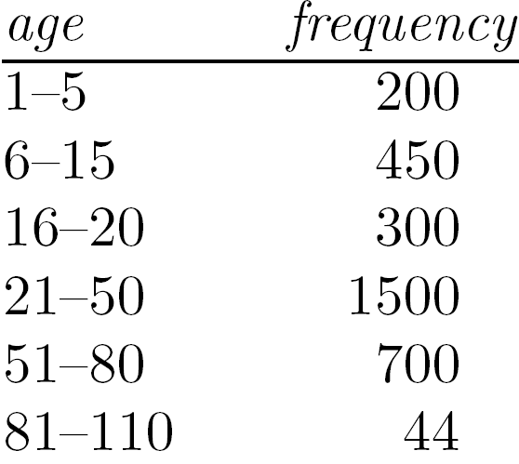
Measuring the Central Tendency
Mean (algebraic measure) (sample vs. population):
Note: n is sample size and N is population size.
Weighted arithmetic mean:
Trimmed mean: chopping extreme values
Median:
Middle value if odd number of values, or average of the middle two values otherwise
Estimated by interpolation (for grouped data):
Mode
Value that occurs most frequently in the data
Unimodal, bimodal, trimodal
Empirical formula:

Slide 13
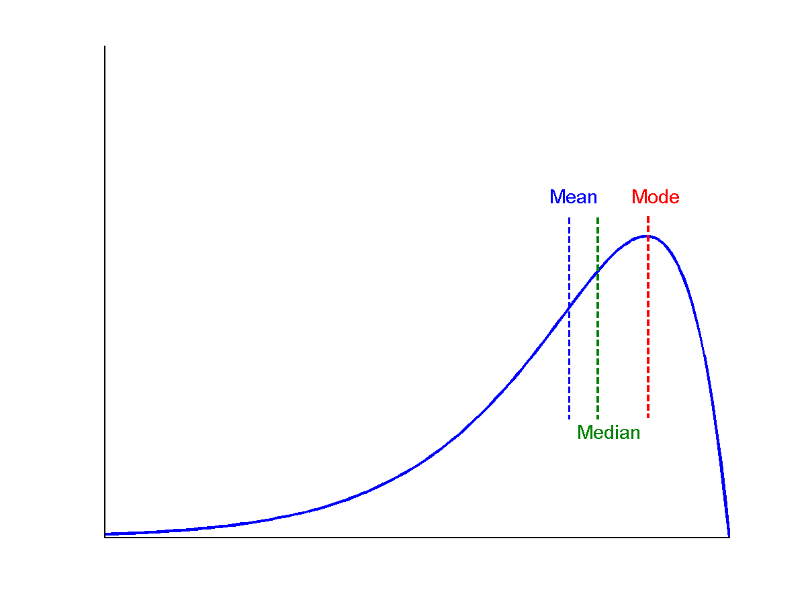
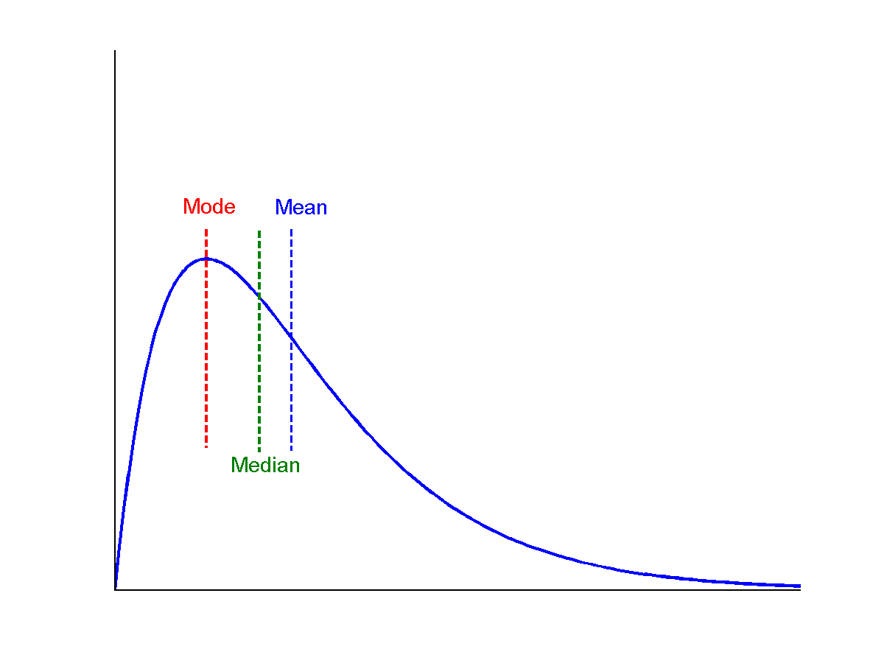
Symmetric vs. Skewed Data
Median, mean and mode of symmetric, positively and negatively skewed data
symmetric
positively skewed
negatively skewed

Slide 14
Measuring the Dispersion of Data
Quartiles, outliers and boxplots
Quartiles: Q₁ (25th percentile), Q₃ (75th percentile)
Inter-quartile range: IQR = Q₃ – Q₁
Five number summary: min, Q₁, median, Q₃, max
Boxplot: ends of the box are the quartiles; median is marked; add whiskers, and plot outliers individually
Outlier: usually, a value higher/lower than 1.5 x IQR
Variance and standard deviation (sample: s, population: σ)
Variance: (algebraic, scalable computation)
Standard deviation s (or σ) is the square root of variance s² ⁽or σ²⁾

Slide 15
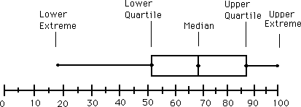
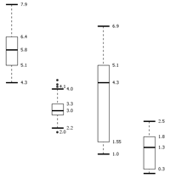
Boxplot Analysis
Five-number summary of a distribution
Minimum, Q1, Median, Q3, Maximum
Boxplot
Data is represented with a box
The ends of the box are at the first and third quartiles, i.e., the height of the box is IQR
The median is marked by a line within the box
Whiskers: two lines outside the box extended to Minimum and Maximum
Outliers: points beyond a specified outlier threshold, plotted individually

Slide 16
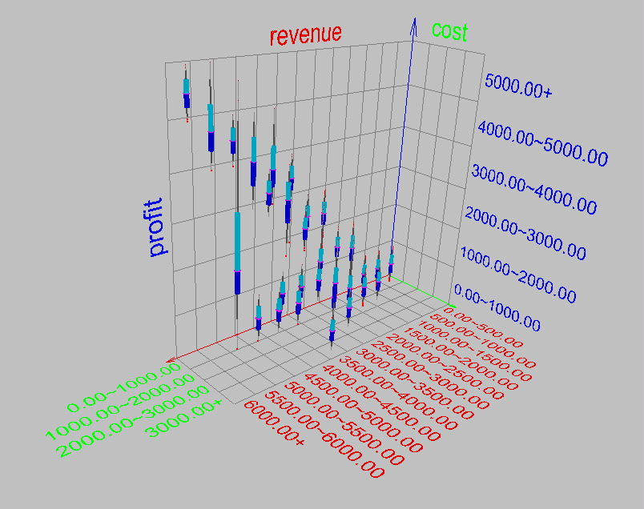
Visualization of Data Dispersion: 3-D Boxplots

Slide 17
Properties of Normal Distribution Curve
The normal (distribution) curve
From μ–σ to μ+σ: contains about 68% of the measurements (μ: mean, σ: standard deviation)
From μ–2σ to μ+2σ: contains about 95% of it
From μ–3σ to μ+3σ: contains about 99.7% of it

Slide 18
Graphic Displays of Basic Statistical Descriptions
Boxplot: graphic display of five-number summary
Histogram: x-axis are values, y-axis repres. frequencies
Quantile plot: each value x_{i} is paired with f_{i} indicating that approximately 100 f_{i} % of data are ≤ x_{i}
Quantile-quantile (q-q) plot: graphs the quantiles of one univariant distribution against the corresponding quantiles of another
Scatter plot: each pair of values is a pair of coordinates and plotted as points in the plane

Slide 19
Histogram Analysis
Histogram: Graph display of tabulated frequencies, shown as bars
It shows what proportion of cases fall into each of several categories
Differs from a bar chart in that it is the area of the bar that denotes the value, not the height as in bar charts, a crucial distinction when the categories are not of uniform width
The categories are usually specified as non-overlapping intervals of some variable. The categories (bars) must be adjacent

Slide 20
Histograms Often Tell More than Boxplots
The two histograms shown in the left may have the same boxplot representation
The same values for: min, Q1, median, Q3, max
But they have rather different data distributions

Slide 21
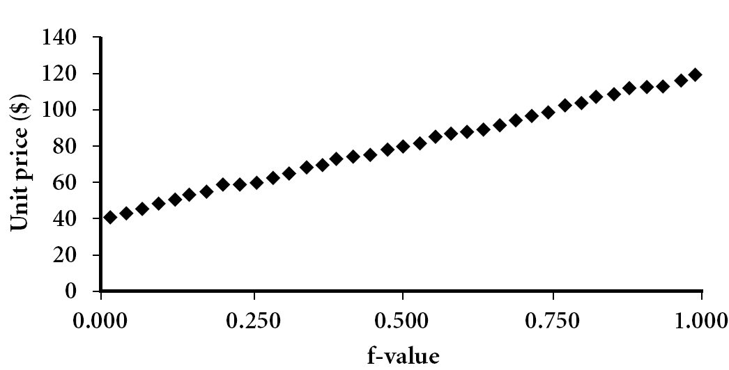
Quantile Plot
Displays all of the data (allowing the user to assess both the overall behavior and unusual occurrences)
Plots quantile information
For a data x_{i} data sorted in increasing order, f_{i} indicates that approximately 100 f_{i}% of the data are below or equal to the value x_{i}

Slide 22
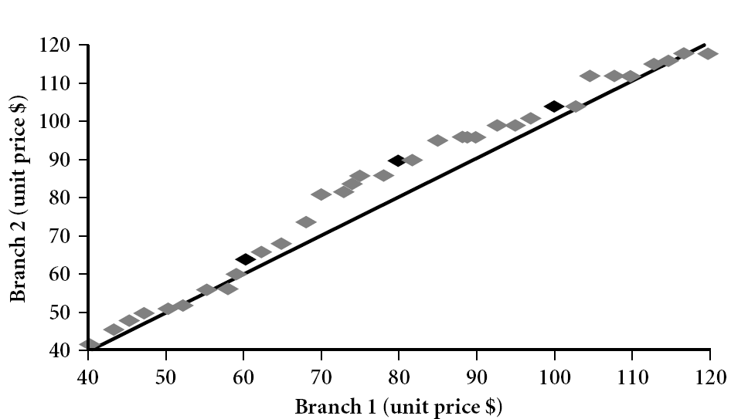
Quantile-Quantile (Q-Q) Plot
Graphs the quantiles of one univariate distribution against the corresponding quantiles of another
View: Is there is a shift in going from one distribution to another?
Example shows unit price of items sold at Branch 1 vs. Branch 2 for each quantile. Unit prices of items sold at Branch 1 tend to be lower than those at Branch 2.
Notes:
Note: We need to label the dark plotted points as Q1, Median, Q3 – that would help in understanding this graph.
Tell audience: There is a shift in distribution of branch 1 WRT branch 2 in that the unit prices of items sold at branch 1 tend to be lower than those at branch 2.

Slide 23
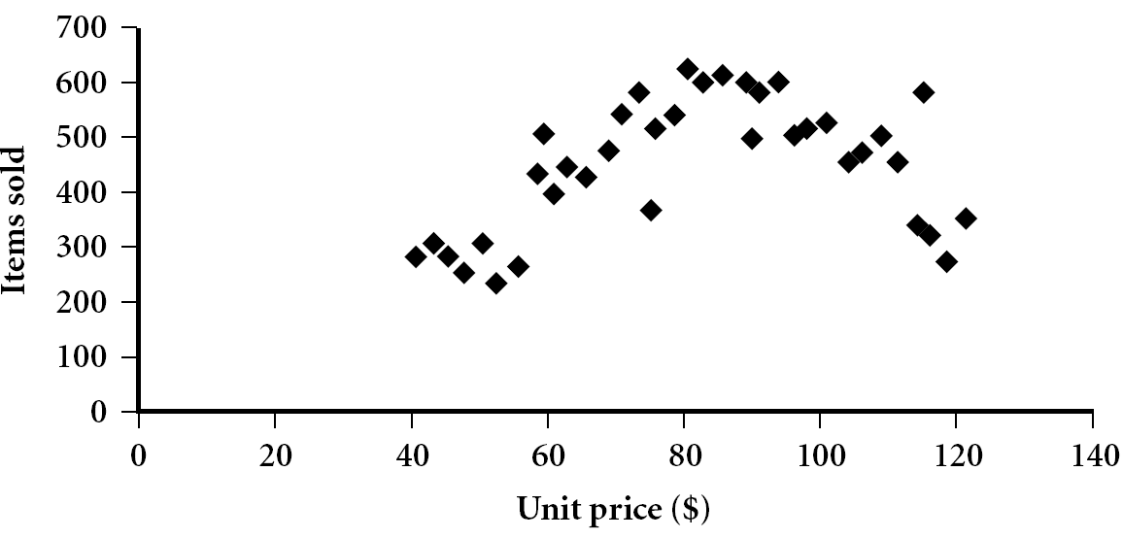
Scatter plot
Provides a first look at bivariate data to see clusters of points, outliers, etc
Each pair of values is treated as a pair of coordinates and plotted as points in the plane

Slide 24
Positively and Negatively Correlated Data
The left half fragment is positively correlated
The right half is negative correlated

Slide 25
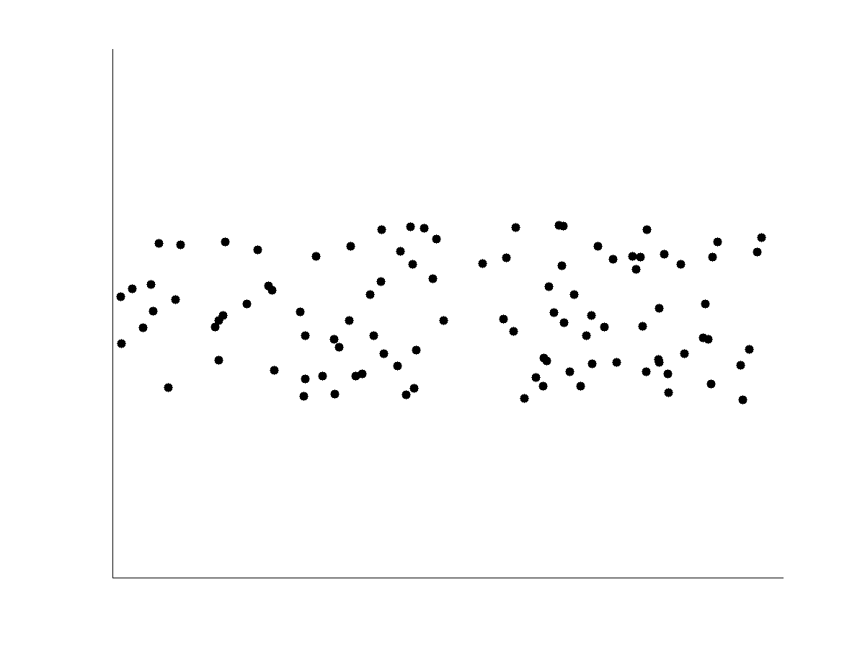
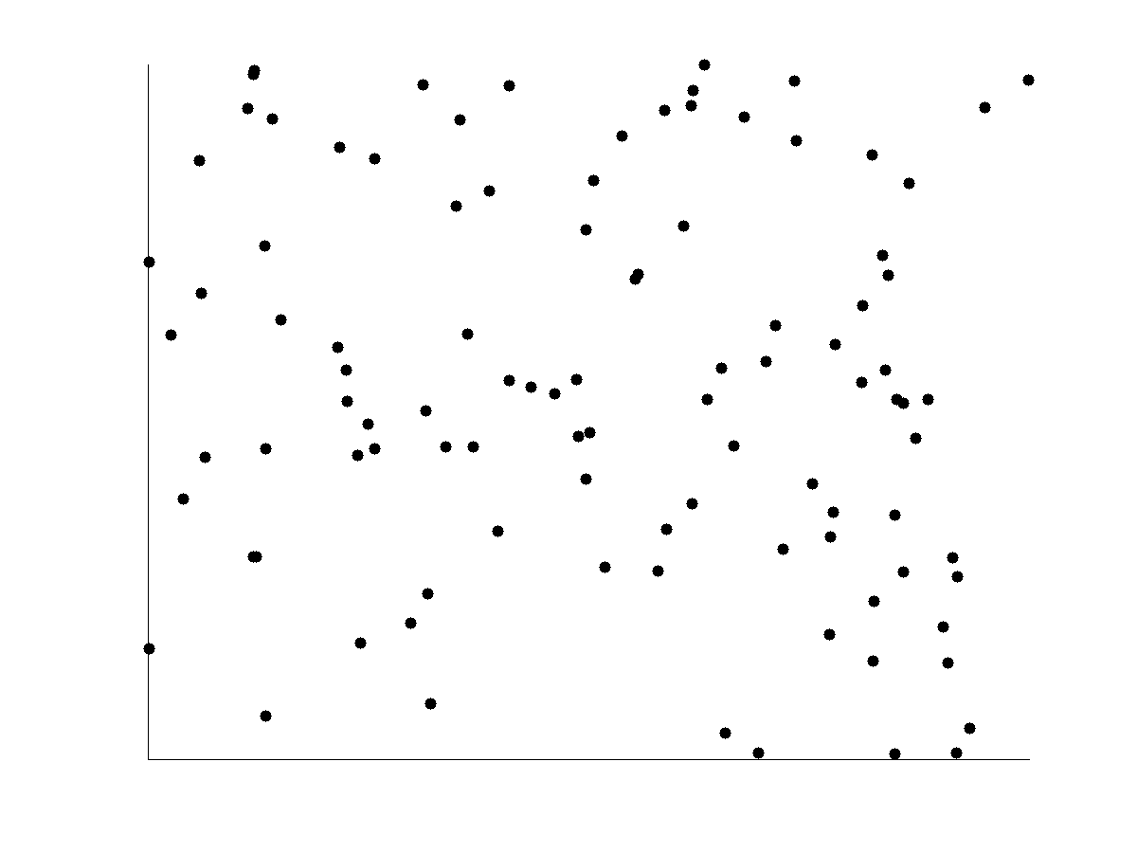
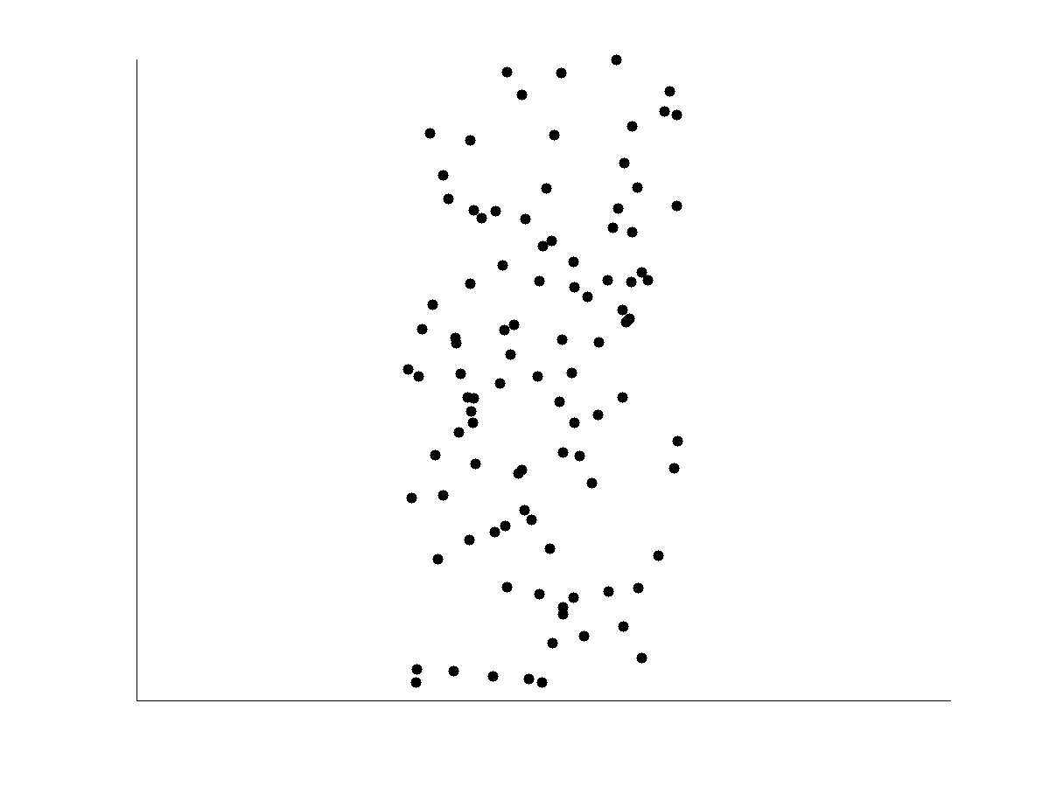
Uncorrelated Data

Slide 26
Data Mining: Concepts and Techniques (3rd ed.) — Chapter 8 —
Jiawei Han, Micheline Kamber, and Jian Pei
University of Illinois at Urbana-Champaign &
Simon Fraser University
©2011 Han, Kamber & Pei. All rights reserved.
26
Notes:
26

Slide 27
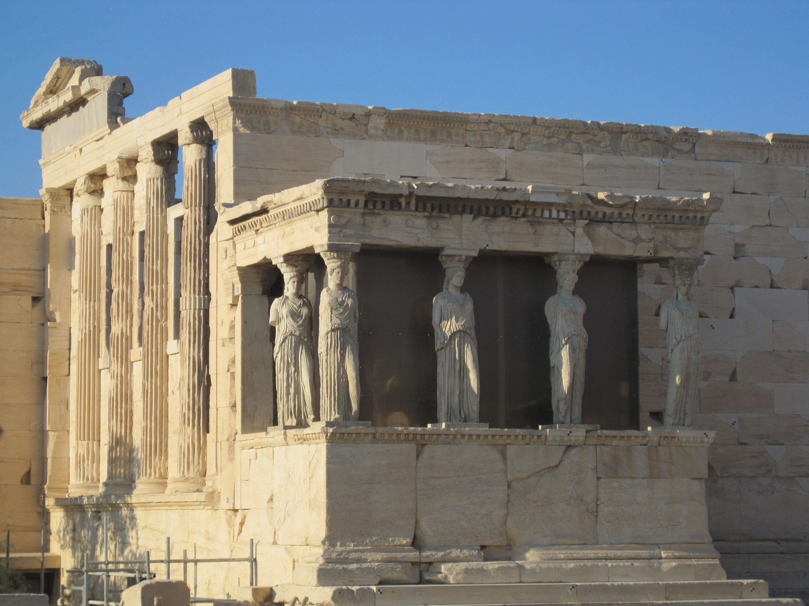

Slide 28
Chapter 8. Classification: Basic Concepts
Classification: Basic Concepts
Decision Tree Induction
Bayes Classification Methods
Rule-Based Classification
Model Evaluation and Selection
Techniques to Improve Classification Accuracy: Ensemble Methods
Summary
28
Notes:
28

Slide 29
Supervised vs. Unsupervised Learning
Supervised learning (classification)
Supervision: The training data (observations, measurements, etc.) are accompanied by labels indicating the class of the observations
New data is classified based on the training set
Unsupervised learning (clustering)
The class labels of training data is unknown
Given a set of measurements, observations, etc. with the aim of establishing the existence of classes or clusters in the data

Slide 30
Prediction Problems: Classification vs. Numeric Prediction
Classification
predicts categorical class labels (discrete or nominal)
classifies data (constructs a model) based on the training set and the values (class labels) in a classifying attribute and uses it in classifying new data
Numeric Prediction
models continuous-valued functions, i.e., predicts unknown or missing values
Typical applications
Credit/loan approval:
Medical diagnosis: if a tumor is cancerous or benign
Fraud detection: if a transaction is fraudulent
Web page categorization: which category it is

Slide 31
Classification—A Two-Step Process
Model construction: describing a set of predetermined classes
Each tuple/sample is assumed to belong to a predefined class, as determined by the class label attribute
The set of tuples used for model construction is training set
The model is represented as classification rules, decision trees, or mathematical formulae
Model usage: for classifying future or unknown objects
Estimate accuracy of the model
The known label of test sample is compared with the classified result from the model
Accuracy rate is the percentage of test set samples that are correctly classified by the model
Test set is independent of training set (otherwise overfitting)
If the accuracy is acceptable, use the model to classify new data
Note: If the test set is used to select models, it is called validation (test) set

Slide 32
Process (1): Model Construction
Classification
Algorithms
Training
Data
Classifier
(Model)
IF rank = ‘professor’
OR years > 6
THEN tenured = ‘yes’

Slide 33
Process (2): Using the Model in Prediction
Classifier
Testing
Data
Unseen Data
(Jeff, Professor, 4)
Tenured?

Slide 34
Chapter 8. Classification: Basic Concepts
Classification: Basic Concepts
Decision Tree Induction
Bayes Classification Methods
Rule-Based Classification
Model Evaluation and Selection
Techniques to Improve Classification Accuracy: Ensemble Methods
Summary
34
Notes:
34

Slide 35
Decision Tree Induction: An Example
Training data set: Buys_computer
The data set follows an example of Quinlan’s ID3 (Playing Tennis)
Resulting tree:
age?
<=30
overcast
>40
31..40
student?
yes
credit rating?
no
yes
excellent
fair
no
yes
no
yes

Slide 36
Algorithm for Decision Tree Induction
Basic algorithm (a greedy algorithm)
Tree is constructed in a top-down recursive divide-and-conquer manner
At start, all the training examples are at the root
Attributes are categorical (if continuous-valued, they are discretized in advance)
Examples are partitioned recursively based on selected attributes
Test attributes are selected on the basis of a heuristic or statistical measure (e.g., information gain)
Conditions for stopping partitioning
All samples for a given node belong to the same class
There are no remaining attributes for further partitioning – majority voting is employed for classifying the leaf
There are no samples left

Slide 37
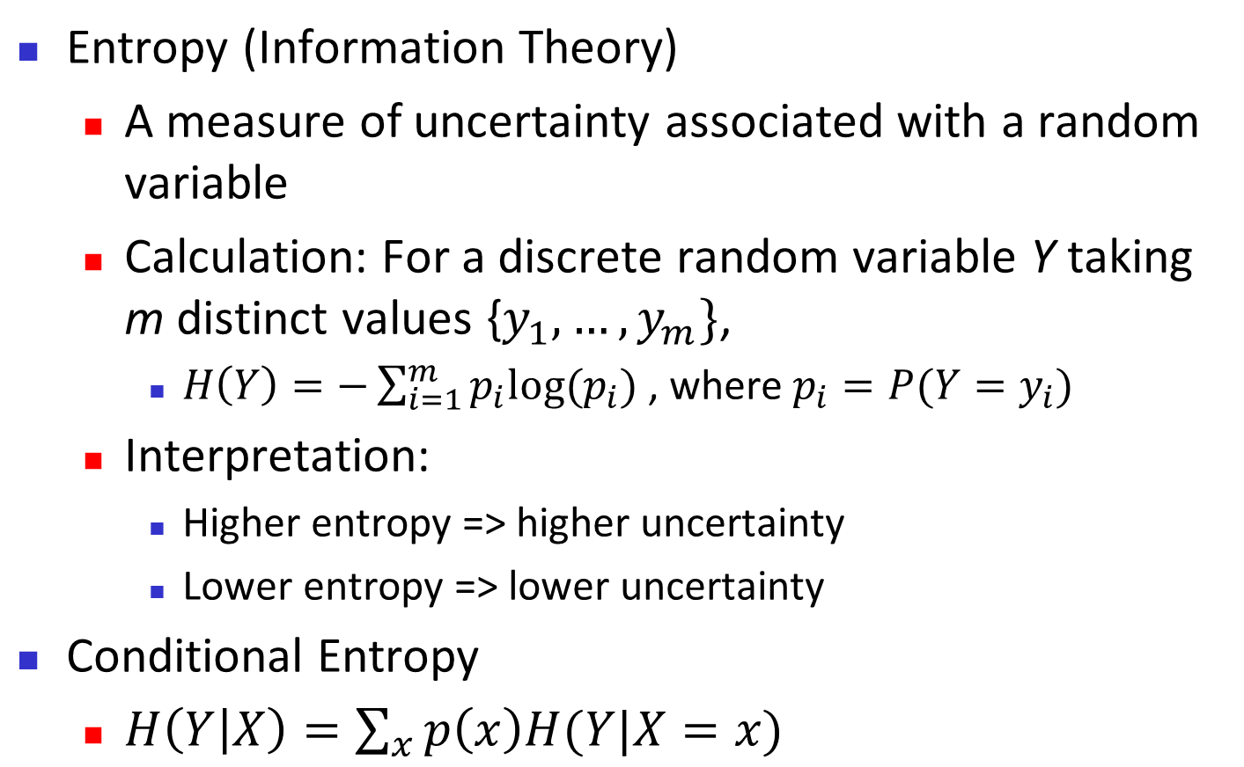
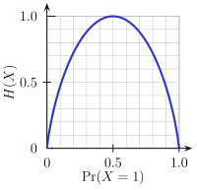
Brief Review of Entropy
m = 2

Slide 38
Attribute Selection Measure: Information Gain (ID3/C4.5)
Select the attribute with the highest information gain
Let p_{i} be the probability that an arbitrary tuple in D belongs to class C_{i}, estimated by |C_{i, D}|/|D|
Expected information (entropy) needed to classify a tuple in D:
Information needed (after using A to split D into v partitions) to classify D:
Information gained by branching on attribute A
Notes:
I : the expected information needed to classify a given sample
E (entropy) : expected information based on the partitioning into subsets by A

Slide 39
Attribute Selection: Information Gain
Class P: buys_computer = “yes”
Class N: buys_computer = “no”
means “age <=30” has 5 out of 14 samples, with 2 yes’es and 3 no’s. Hence
Similarly,

Slide 40
Computing Information-Gain for Continuous-Valued Attributes
Let attribute A be a continuous-valued attribute
Must determine the best split point for A
Sort the value A in increasing order
Typically, the midpoint between each pair of adjacent values is considered as a possible split point
(a_{i}+a_{i+1})/2 is the midpoint between the values of a_{i} and a_{i+1}
The point with the minimum expected information requirement for A is selected as the split-point for A
Split:
D1 is the set of tuples in D satisfying A ≤ split-point, and D2 is the set of tuples in D satisfying A > split-point

Slide 41
Gain Ratio for Attribute Selection (C4.5)
Information gain measure is biased towards attributes with a large number of values
C4.5 (a successor of ID3) uses gain ratio to overcome the problem (normalization to information gain)
GainRatio(A) = Gain(A)/SplitInfo(A)
Ex.
gain_ratio(income) = 0.029/1.557 = 0.019
The attribute with the maximum gain ratio is selected as the splitting attribute

Slide 42
Gini Index (CART, IBM IntelligentMiner)
If a data set D contains examples from n classes, gini index, gini(D) is defined as
where p_{j} is the relative frequency of class j in D
If a data set D is split on A into two subsets D₁ and D₂, the gini index gini(D) is defined as
Reduction in Impurity:
The attribute provides the smallest gini_{split}(D) (or the largest reduction in impurity) is chosen to split the node (need to enumerate all the possible splitting points for each attribute)

Slide 43
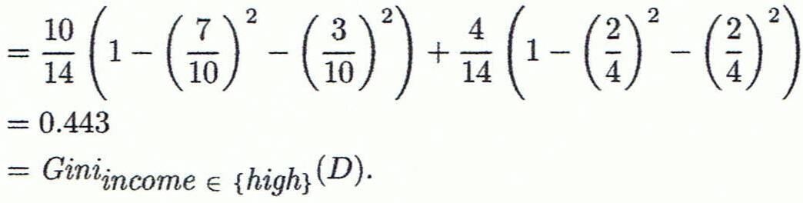
Computation of Gini Index
Ex. D has 9 tuples in buys_computer = “yes” and 5 in “no”
Suppose the attribute income partitions D into 10 in D₁: {low, medium} and 4 in D₂
Gini_{{low,high}} is 0.458; Gini_{{medium,high}} is 0.450. Thus, split on the {low,medium} (and {high}) since it has the lowest Gini index
All attributes are assumed continuous-valued
May need other tools, e.g., clustering, to get the possible split values
Can be modified for categorical attributes

Slide 44
Comparing Attribute Selection Measures
The three measures, in general, return good results but
Information gain:
biased towards multivalued attributes
Gain ratio:
tends to prefer unbalanced splits in which one partition is much smaller than the others
Gini index:
biased to multivalued attributes
has difficulty when # of classes is large
tends to favor tests that result in equal-sized partitions and purity in both partitions

Slide 45
Other Attribute Selection Measures
CHAID: a popular decision tree algorithm, measure based on χ² test for independence
C-SEP: performs better than info. gain and gini index in certain cases
G-statistic: has a close approximation to χ² distribution
MDL (Minimal Description Length) principle (i.e., the simplest solution is preferred):
The best tree as the one that requires the fewest # of bits to both (1) encode the tree, and (2) encode the exceptions to the tree
Multivariate splits (partition based on multiple variable combinations)
CART: finds multivariate splits based on a linear comb. of attrs.
Which attribute selection measure is the best?
Most give good results, none is significantly superior than others

Slide 46
Overfitting and Tree Pruning
Overfitting: An induced tree may overfit the training data
Too many branches, some may reflect anomalies due to noise or outliers
Poor accuracy for unseen samples
Two approaches to avoid overfitting
Prepruning: Halt tree construction early ̵ do not split a node if this would result in the goodness measure falling below a threshold
Difficult to choose an appropriate threshold
Postpruning: Remove branches from a “fully grown” tree—get a sequence of progressively pruned trees
Use a set of data different from the training data to decide which is the “best pruned tree”

Slide 47
Enhancements to Basic Decision Tree Induction
Allow for continuous-valued attributes
Dynamically define new discrete-valued attributes that partition the continuous attribute value into a discrete set of intervals
Handle missing attribute values
Assign the most common value of the attribute
Assign probability to each of the possible values
Attribute construction
Create new attributes based on existing ones that are sparsely represented
This reduces fragmentation, repetition, and replication

Slide 48
Classification in Large Databases
Classification—a classical problem extensively studied by statisticians and machine learning researchers
Scalability: Classifying data sets with millions of examples and hundreds of attributes with reasonable speed
Why is decision tree induction popular?
relatively faster learning speed (than other classification methods)
convertible to simple and easy to understand classification rules
can use SQL queries for accessing databases
comparable classification accuracy with other methods
RainForest (VLDB’98 — Gehrke, Ramakrishnan & Ganti)
Builds an AVC-list (attribute, value, class label)

Slide 49
Scalability Framework for RainForest
Separates the scalability aspects from the criteria that determine the quality of the tree
Builds an AVC-list: AVC (Attribute, Value, Class_label)
AVC-set (of an attribute X )
Projection of training dataset onto the attribute X and class label where counts of individual class label are aggregated
AVC-group (of a node n )
Set of AVC-sets of all predictor attributes at the node n

Slide 50
Rainforest: Training Set and Its AVC Sets
Training Examples
AVC-set on Age
AVC-set on income
Age | Buy_Computer
 | yes | no
<=30 | 2 | 3
31..40 | 4 | 0
>40 | 3 | 2
income | Buy_Computer
 | yes | no
high | 2 | 2
medium | 4 | 2
low | 3 | 1
AVC-set on
credit_rating
AVC-set on Student
student | Buy_Computer
 | yes | no
yes | 6 | 1
no | 3 | 4
Credit rating | Buy_Computer
 | yes | no
fair | 6 | 2
excellent | 3 | 3

Slide 51
BOAT (Bootstrapped Optimistic Algorithm for Tree Construction)
Use a statistical technique called bootstrapping to create several smaller samples (subsets), each fits in memory
Each subset is used to create a tree, resulting in several trees
These trees are examined and used to construct a new tree T’
It turns out that T’ is very close to the tree that would be generated using the whole data set together
Adv: requires only two scans of DB, an incremental alg.
51
Notes:
51

Slide 52
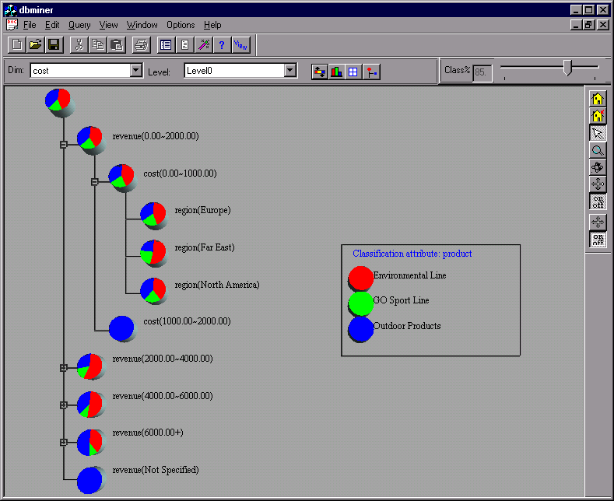
Presentation of Classification Results

Slide 53
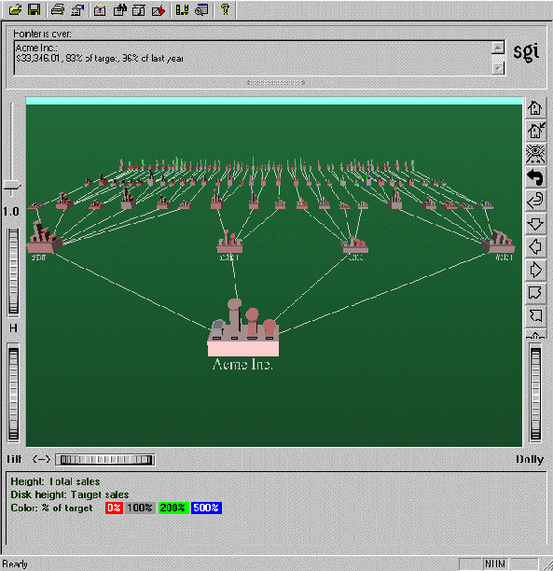
Visualization of a Decision Tree in SGI/MineSet 3.0

Slide 54
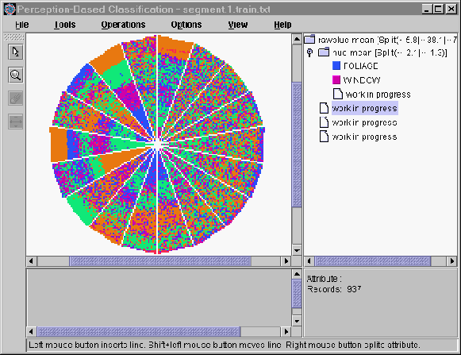
Interactive Visual Mining by Perception-Based Classification (PBC)

Slide 55
Data Mining: Concepts and Techniques (3rd ed.) — Chapter 10 —
Jiawei Han, Micheline Kamber, and Jian Pei
University of Illinois at Urbana-Champaign &
Simon Fraser University
©2011 Han, Kamber & Pei. All rights reserved.
Notes:
55

Slide 56
Chapter 10. Cluster Analysis: Basic Concepts and Methods
Cluster Analysis: Basic Concepts
Partitioning Methods
Hierarchical Methods
Density-Based Methods
Grid-Based Methods
Evaluation of Clustering
Summary
56
56
Notes:
56

Slide 57
What is Cluster Analysis?
Cluster: A collection of data objects
similar (or related) to one another within the same group
dissimilar (or unrelated) to the objects in other groups
Cluster analysis (or clustering, data segmentation, …)
Finding similarities between data according to the characteristics found in the data and grouping similar data objects into clusters
Unsupervised learning: no predefined classes (i.e., learning by observations vs. learning by examples: supervised)
Typical applications
As a stand-alone tool to get insight into data distribution
As a preprocessing step for other algorithms

Slide 58
Clustering for Data Understanding and Applications
Biology: taxonomy of living things: kingdom, phylum, class, order, family, genus and species
Information retrieval: document clustering
Land use: Identification of areas of similar land use in an earth observation database
Marketing: Help marketers discover distinct groups in their customer bases, and then use this knowledge to develop targeted marketing programs
City-planning: Identifying groups of houses according to their house type, value, and geographical location
Earth-quake studies: Observed earth quake epicenters should be clustered along continent faults
Climate: understanding earth climate, find patterns of atmospheric and ocean
Economic Science: market resarch

Slide 59
Clustering as a Preprocessing Tool (Utility)
Summarization:
Preprocessing for regression, PCA, classification, and association analysis
Compression:
Image processing: vector quantization
Finding K-nearest Neighbors
Localizing search to one or a small number of clusters
Outlier detection
Outliers are often viewed as those “far away” from any cluster

Slide 60
Quality: What Is Good Clustering?
A good clustering method will produce high quality clusters
high intra-class similarity: cohesive within clusters
low inter-class similarity: distinctive between clusters
The quality of a clustering method depends on
the similarity measure used by the method
its implementation, and
Its ability to discover some or all of the hidden patterns

Slide 61
Measure the Quality of Clustering
Dissimilarity/Similarity metric
Similarity is expressed in terms of a distance function, typically metric: d(i, j)
The definitions of distance functions are usually rather different for interval-scaled, boolean, categorical, ordinal ratio, and vector variables
Weights should be associated with different variables based on applications and data semantics
Quality of clustering:
There is usually a separate “quality” function that measures the “goodness” of a cluster.
It is hard to define “similar enough” or “good enough”
The answer is typically highly subjective

Slide 62
Considerations for Cluster Analysis
Partitioning criteria
Single level vs. hierarchical partitioning (often, multi-level hierarchical partitioning is desirable)
Separation of clusters
Exclusive (e.g., one customer belongs to only one region) vs. non-exclusive (e.g., one document may belong to more than one class)
Similarity measure
Distance-based (e.g., Euclidian, road network, vector) vs. connectivity-based (e.g., density or contiguity)
Clustering space
Full space (often when low dimensional) vs. subspaces (often in high-dimensional clustering)

Slide 63
Requirements and Challenges
Scalability
Clustering all the data instead of only on samples
Ability to deal with different types of attributes
Numerical, binary, categorical, ordinal, linked, and mixture of these
Constraint-based clustering
User may give inputs on constraints
Use domain knowledge to determine input parameters
Interpretability and usability
Others
Discovery of clusters with arbitrary shape
Ability to deal with noisy data
Incremental clustering and insensitivity to input order
High dimensionality

Slide 64
Major Clustering Approaches (I)
Partitioning approach:
Construct various partitions and then evaluate them by some criterion, e.g., minimizing the sum of square errors
Typical methods: k-means, k-medoids, CLARANS
Hierarchical approach:
Create a hierarchical decomposition of the set of data (or objects) using some criterion
Typical methods: Diana, Agnes, BIRCH, CAMELEON
Density-based approach:
Based on connectivity and density functions
Typical methods: DBSACN, OPTICS, DenClue
Grid-based approach:
based on a multiple-level granularity structure
Typical methods: STING, WaveCluster, CLIQUE

Slide 65
Major Clustering Approaches (II)
Model-based:
A model is hypothesized for each of the clusters and tries to find the best fit of that model to each other
Typical methods: EM, SOM, COBWEB
Frequent pattern-based:
Based on the analysis of frequent patterns
Typical methods: p-Cluster
User-guided or constraint-based:
Clustering by considering user-specified or application-specific constraints
Typical methods: COD (obstacles), constrained clustering
Link-based clustering:
Objects are often linked together in various ways
Massive links can be used to cluster objects: SimRank, LinkClus

Slide 66
Chapter 10. Cluster Analysis: Basic Concepts and Methods
Cluster Analysis: Basic Concepts
Partitioning Methods
Hierarchical Methods
Density-Based Methods
Grid-Based Methods
Evaluation of Clustering
Summary
66
66
Notes:
66

Slide 67
Partitioning Algorithms: Basic Concept
Partitioning method: Partitioning a database D of n objects into a set of k clusters, such that the sum of squared distances is minimized (where c_{i} is the centroid or medoid of cluster C_{i})
Given k, find a partition of k clusters that optimizes the chosen partitioning criterion
Global optimal: exhaustively enumerate all partitions
Heuristic methods: k-means and k-medoids algorithms
k-means (MacQueen’67, Lloyd’57/’82): Each cluster is represented by the center of the cluster
k-medoids or PAM (Partition around medoids) (Kaufman & Rousseeuw’87): Each cluster is represented by one of the objects in the cluster

Slide 68
The K-Means Clustering Method
Given k, the k-means algorithm is implemented in four steps:
Partition objects into k nonempty subsets
Compute seed points as the centroids of the clusters of the current partitioning (the centroid is the center, i.e., mean point, of the cluster)
Assign each object to the cluster with the nearest seed point
Go back to Step 2, stop when the assignment does not change

Slide 69
An Example of K-Means Clustering
K=2
Arbitrarily partition objects into k groups
Update the cluster centroids
The initial data set
Loop if needed
Reassign objects
Partition objects into k nonempty subsets
Repeat
Compute centroid (i.e., mean point) for each partition
Assign each object to the cluster of its nearest centroid
Until no change
Update the cluster centroids

Slide 70
Comments on the K-Means Method
Strength: Efficient: O(tkn), where n is # objects, k is # clusters, and t is # iterations. Normally, k, t << n.
Comparing: PAM: O(k(n-k)² ), CLARA: O(ks² + k(n-k))
Comment: Often terminates at a local optimal.
Weakness
Applicable only to objects in a continuous n-dimensional space
Using the k-modes method for categorical data
In comparison, k-medoids can be applied to a wide range of data
Need to specify k, the number of clusters, in advance (there are ways to automatically determine the best k (see Hastie et al., 2009)
Sensitive to noisy data and outliers
Not suitable to discover clusters with non-convex shapes

Slide 71
Variations of the K-Means Method
Most of the variants of the k-means which differ in
Selection of the initial k means
Dissimilarity calculations
Strategies to calculate cluster means
Handling categorical data: k-modes
Replacing means of clusters with modes
Using new dissimilarity measures to deal with categorical objects
Using a frequency-based method to update modes of clusters
A mixture of categorical and numerical data: k-prototype method

Slide 72
What Is the Problem of the K-Means Method?
The k-means algorithm is sensitive to outliers !
Since an object with an extremely large value may substantially distort the distribution of the data
K-Medoids: Instead of taking the mean value of the object in a cluster as a reference point, medoids can be used, which is the most centrally located object in a cluster
10
10
9
9
8
8
7
7
6
6
5
5
4
4
3
3
2
2
1
1
0
0
1
2
3
4
5
6
7
8
9
10
0
0
1
2
3
4
5
6
7
8
9
10

Slide 73
PAM: A Typical K-Medoids Algorithm
Total Cost = 20
10
9
8
Arbitrary choose k object as initial medoids
Assign each remaining object to nearest medoids
7
6
5
4
3
2
1
0
0
1
2
3
4
5
6
7
8
9
10
K=2
Randomly select a nonmedoid object,O_{ramdom}
Total Cost = 26
Do loop
Until no change
10
10
9
Compute total cost of swapping
9
Swapping O and O_{ramdom}
If quality is improved.
8
8
7
7
6
6
5
5
4
4
3
3
2
2
1
1
0
0
1
2
3
4
5
6
7
8
9
10
0
0
1
2
3
4
5
6
7
8
9
10
73
Notes:
73

Slide 74
The K-Medoid Clustering Method
K-Medoids Clustering: Find representative objects (medoids) in clusters
PAM (Partitioning Around Medoids, Kaufmann & Rousseeuw 1987)
Starts from an initial set of medoids and iteratively replaces one of the medoids by one of the non-medoids if it improves the total distance of the resulting clustering
PAM works effectively for small data sets, but does not scale well for large data sets (due to the computational complexity)
Efficiency improvement on PAM
CLARA (Kaufmann & Rousseeuw, 1990): PAM on samples
CLARANS (Ng & Han, 1994): Randomized re-sampling

